Slide 1
DS/DST PROJECT
SETS & COMBINATIONS
Malay Raj x Kabir Koli

Slide 2
OUR
PROGRAM
A RESOURCE PORTAL
We will build an interactive website showcasing the different patterns and hidden relationships of the Pascal's Triangle in other mathematical applications. It will also include an interactive Tower of Hanoi puzzle for people to solve. It will serve as an helpful, informative source for those who are curious in the topic.

Slide 3
OUR FOCUS
PASCAL'S TRIANGLE, TOWER OF HANOI & BINOMIAL SERIES

Slide 4
What our program will consist of
TOWER OF HANOI
BINOMIAL SERIES
An interactive Tower of Hanoi game that people can play online
This section will calculate the coefficients of a binomial series of the form (a + x)^n
PROBABILITY
COMBINATIONS
With the help of Pascal's triangle, here, we will show how many ways simultaneous coin tosses can occur.
Our website will be able to calculate the number of combinations of objects possible and will relate this result with the pascal's triangle.

Slide 5
PASCAL'S TRIANGLE
In mathematics, Pascal's triangle is a triangular Array of the binomial coefficients.

Slide 6
INTERESTING FACTS
CONSECUTIVE PAIRS
Sum of every pair of consecutive elements gives us the corresponding element to the bottom of the pair.
SUM
RELATION WITH 11
The sum of each row in a pascal's triangle is 2^n
Each row of a Pascal's Triangle is a power of 11

Slide 7
HOMEPAGE CODE

Slide 8

PROBABILITIES VIA PASCAL'S TRIANGLE
AN EXAMPLE
Suppose 4 coins are tossed simultaneously, and we want to find out probability of getting exactly 2 heads in this event.

Slide 9
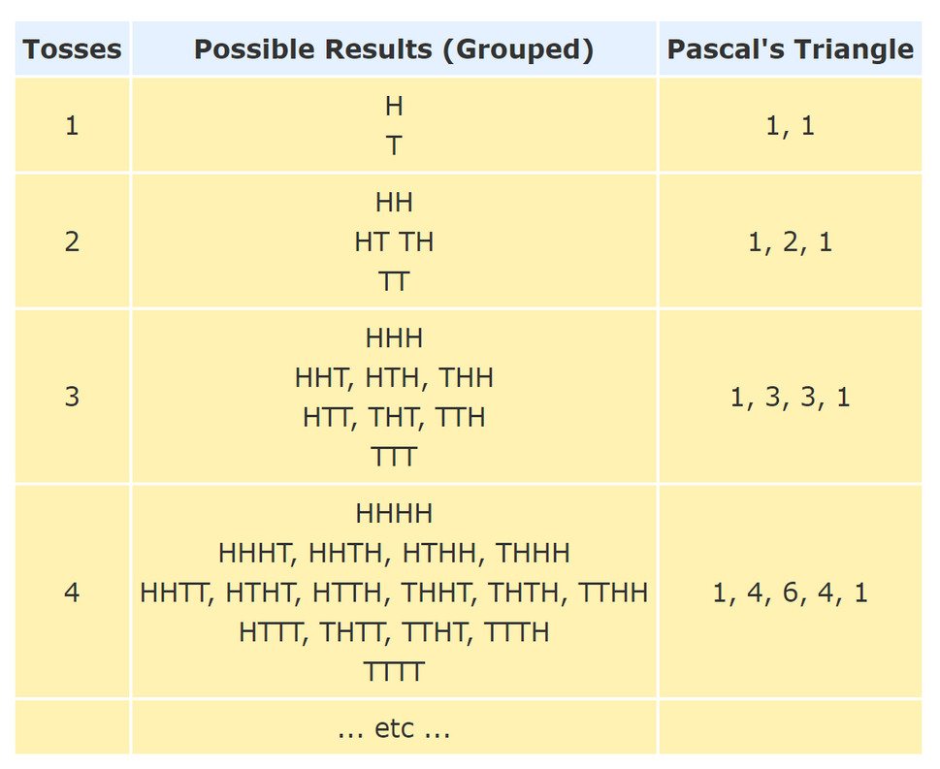
TOTAL OUTCOMES
We look at the 4th row of the pascal's triangle and upon adding the elements we get 1 + 4 + 6 + 4 + 1 = 16.
FAVOURABLE OUTCOMES
For 2 heads, we head to row 4, column 2 - hence we get 6.
PLUG IN THE FORMULA
Hence the probability to get exactly 2 heads in 4 consecutive coin tosses is 6/16=37.5%
Note : Indexing of rows and columns starts from Zero'

Slide 10
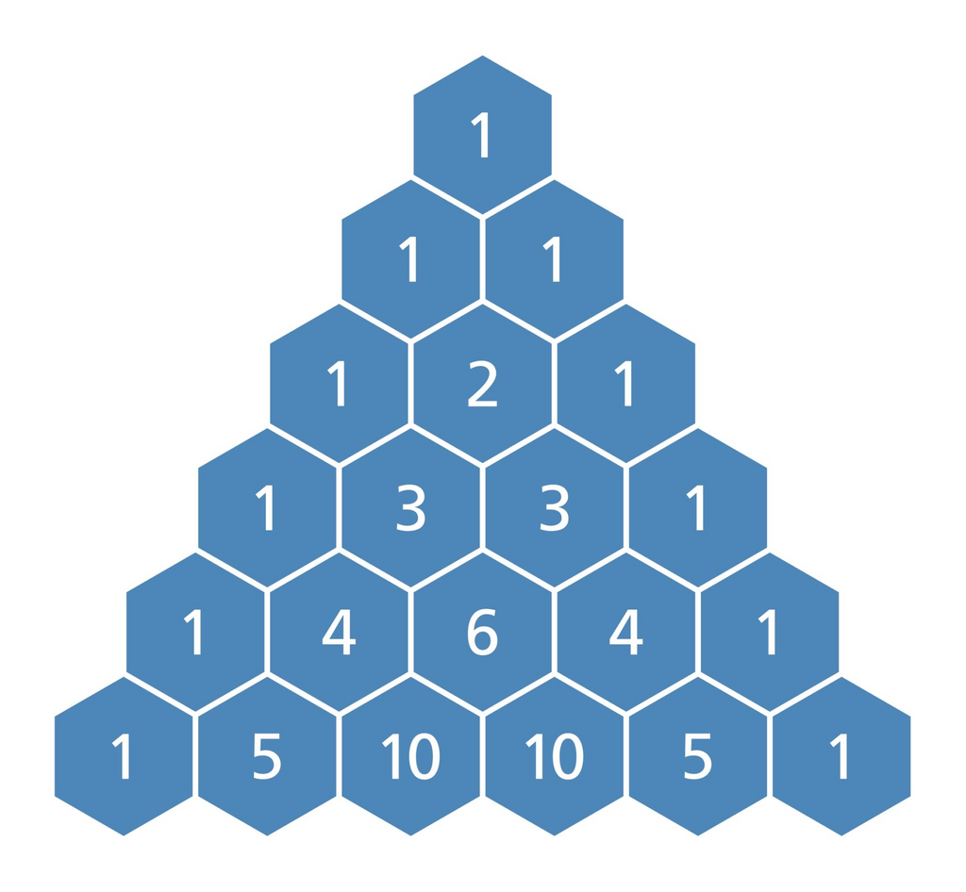
INFOGRAPHIC SECTION
PASCAL'S TRIANGLE SHOWCASE
This section will display the mentioned patterns & applications of the pascal's triangle which will behave accordingly when we hover our mouse cursor.

Slide 11
TOWER OF HANOI
AN ANCIENT PUZZLE
The Tower of Hanoi is a mathematical game or puzzle which consists of three rods and a number of disks of different sizes, which can slide onto any rod. The puzzle starts with the disks in a neat stack in ascending order of size on one rod, the smallest at the top, thus making a conical shape.

Slide 12
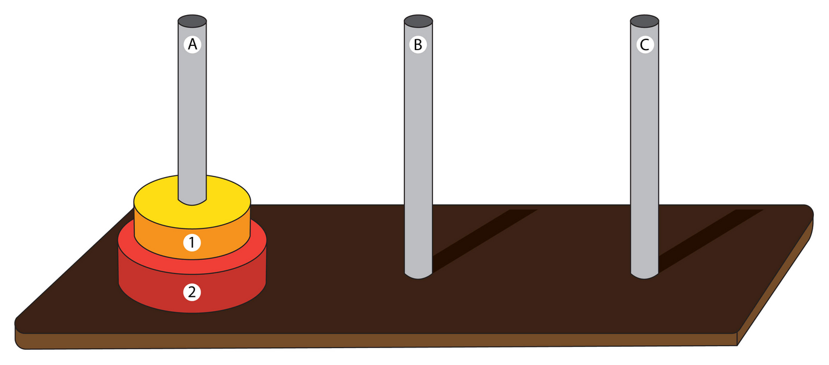
GAME SECTION
In this portion of our website, people will be able to interact with a virtual version of the puzzle. There will be options of choosing n number of discs (upto 5). We will also integrate a hints section which will display the minimum steps required and step - by - step tutorial as well.

Slide 13




LANGUAGES/ FRAMEWORKS USED
Python & Django Web Development framework to start the local server and integrate files
HTML
CSS and Bootstrap for Styling
JavaScript and JQuery framework for the graphics needed for Tower of Hanoi Game

